Slide 1
What Django can learn from web2py
By Samuel Marks

Slide 2
Why move from web2py to Django?
Number of web2py jobs available on careersone, seek and freelancer: 0
Number of Django jobs available on aforementioned job sites: 36
Maybe I should learn PHP instead? >.<

Slide 3
Web2py feature highlights (pt1)
In-built ticketing system for errors
In-built RBAC
In-built services support for JSONRPC, XMLRPC, REST (CSV, JSON, XML) and SOAP
Database Abstraction Layer (DAL) is used rather than an ORM
There‘s a default for everything, e.g.: create a controller function and you have a default view

Slide 4
Web2py feature highlights (pt2)
Decorators for doing useful tasks, e.g. prepending controller functions:
@auth.requires_login()
@auth.requires_permission('read', secrets)
@auth.requires(auth.user_id==1 or request.client=='127.0.0.1', requires_login=True)
@auth.requires_membership('agents')

Slide 5
Web2py feature highlights (pt3)
@service.run
@service.xml
@service.json
@service.rss
@service.csv
@service.xmlrpc
@service.jsonrpc
@service.amfrpc3
@service.soap

Slide 6
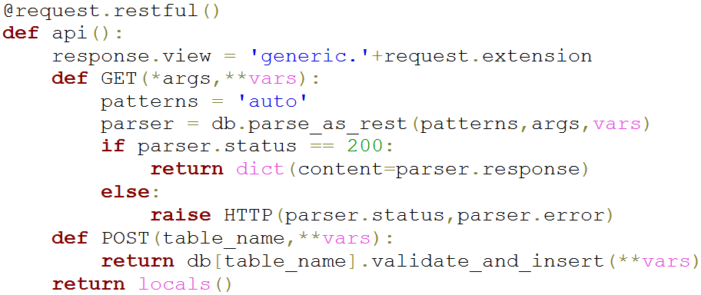
Example usage (REST)

Slide 7
Are there Django equivalents with similar power + simplicity?
☺ [edit this page] ☺

